Slide 1
Statistical Tools and Concepts for Molecular Biologists
Data Visualization Strategies

Slide 2
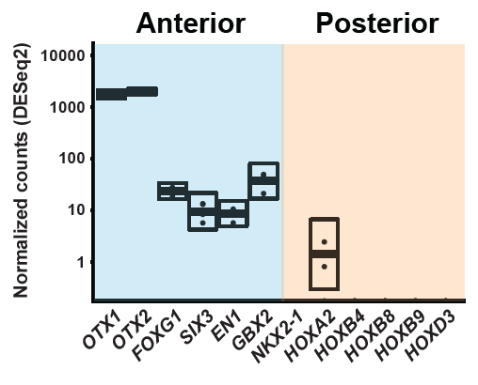
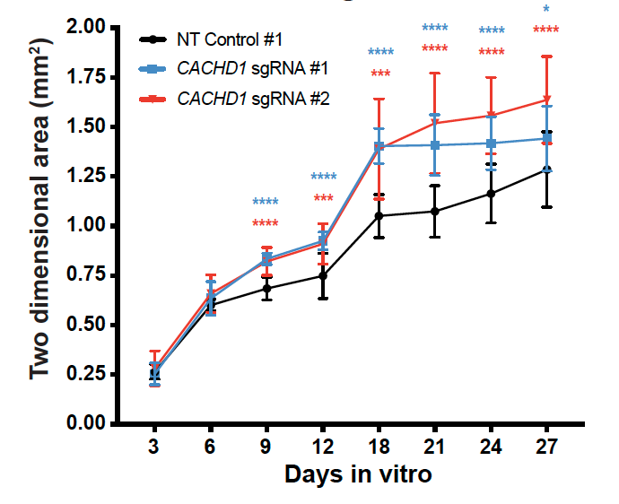
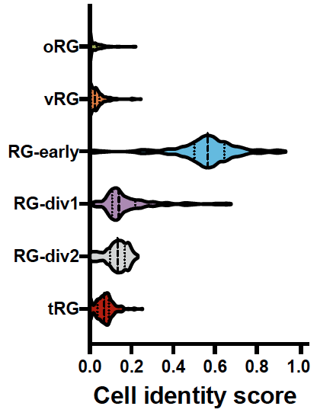
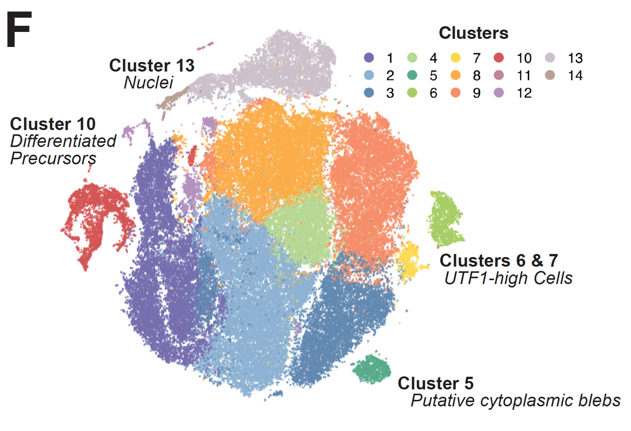
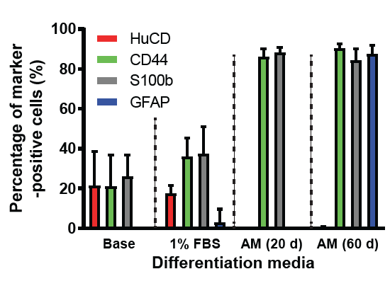
DataViz is an art (with some important rules to follow)
Line plot
Box plot
Violin plot
tSNE plot
Bar plot

Slide 3
Data Visualization Formats
Histograms
Scatter plot
Line plot
Box plot
Violin plot
Dot plot
Bar plot

Slide 4
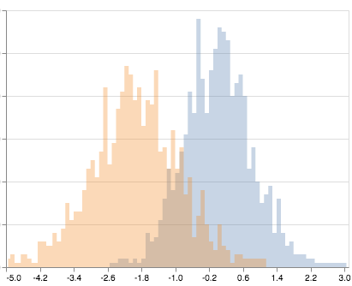
Histogram
Histograms measure the number of values that fall into pre-determined bins over a sample distribution
We set the bin width based on the data
Helpful for quality control
Control Patient
Use case: You have collected blood samples from two groups: controls and patients with a liver disease. You have 100 samples per group and your goal is to determine if circulating concentrations of Factor X is a biomarker for the disease. Before you can run parametric tests, you first need to decide if the data follows a normal distribution for each group.
Frequency of events
Normalized Factor X concentration

Slide 5
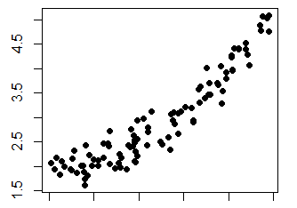
Scatter plot
Scatter plots depict the relationship between two numerical values
Powerful exploratory data tool
Helps you detect patterns and outliers in your data
Use Case: When collecting your data, you noticed that your controls tended to be slightly older than your patients. You are concerned this might affect your data. To check if age has any relationship with Factor X concentration, you could generate a scatter plot of expression vs. age.
Factor X Concentration
20 30 40 50 60
Age

Slide 6
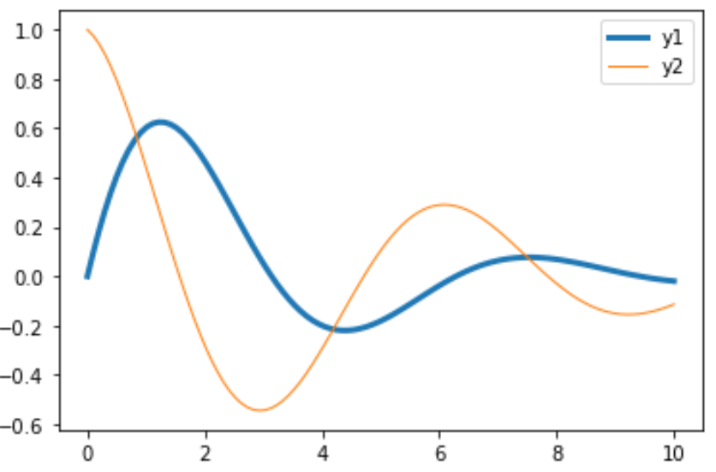
Line plot
Line plots is a display of data over a number line
Often used to show changes of a variable over time
Control Patient
Use Case: For a subset of your subjects, you were able to collect blood samples over the course of 5 months to determine if there are fluctuations in Factor X concentrations. To show change over time, you could use a line plot.
Factor X concentration
(normalized)
0 1 2 3 4 5
Time (months)

Slide 7
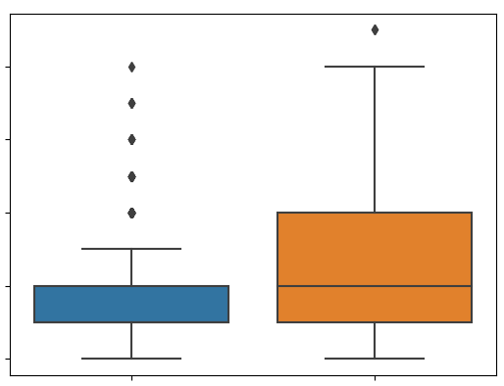
Box plot
Box plots are constructed based on five points. The minimum value, the quartile 1 value (25th percentile), the median, the quartile 3 value (75th percentile) and the maximum value. The box in a box plot is created around quartile 1 (Q1) and quartile 3 (Q3) and is considered the “interquartile range” or IQR
Use Case: When the samples were being collected, you noticed that a couple of subjects had fevers and appeared to be sick. You are concerned that there may be some outliers in your data. You can run an outlier test, but before that, you can generate a box plot to quickly see the range of your data and identify any outliers.
0 5 10 15 20
Concentration of Factor X
Controls Patients

Slide 8
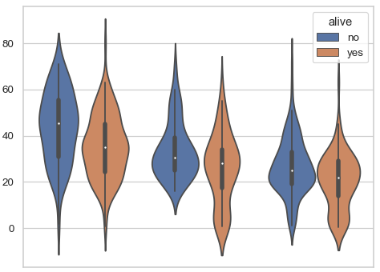
Violin plot
Violin plots depict the distribution for multiple categorical variables simultaneously
Control Patient
Use Case: A couple days before you started your experiment, you received a $1M grant that allows you to run scRNA-seq on each blood sample. You are interested in how Factor X gene expression varies across cell types and control/patient status.
Number of UMIs (normalized)
Lymphocytes
Macrophages
Monocytes
Notes:
0.05 threshold is a somewhat arbitrary cutoff that researchers have coalesced around. It is basically saying that we are ok with having a 5% chance of a false positive.
https://www.youtube.com/watch?v=YSwmpAmLV2s

Slide 9
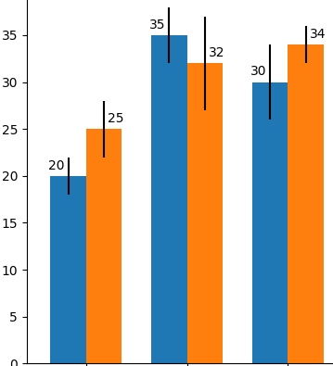
Bar plot
Bar plots present categorial data with rectangular bars with sizes proportional to their values
One of the most common you will see in the literature
Control Patient
Use Case: You decide to validate your scRNA-seq data by FAC sorting a subset of your blood samples and running qPCR to quantify Factor X transcripts. A bar plot is one way to present this data.
Normalized gene expression
Lymphos
Macros
Monos

Slide 10
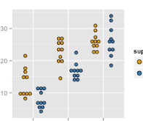
Dot plot
Dot plots is a graph consisting of data points plotted on a simple scale
Good for data in which there are 100 or fewer measurements
Use Case: You are trying to publish your paper, and the journal editor demands that you show every data point. Dot plots are the way to go (or at the very least, a dot plot on top of a box, bar, or violin plot).
Patient
Normalized gene expression
Control
Lymphos
Macros
Monos

Slide 11
General rules for DataViz
Do’s
Keep it simple
White space is important
Label necessary elements
Make data comparisons clear and easy
Don’ts
Overwhelm your audience
Show too little data
Change scales mid-axis
Organize data in a meaningless way

Slide 12
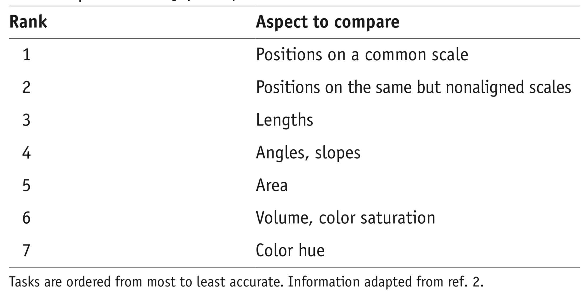
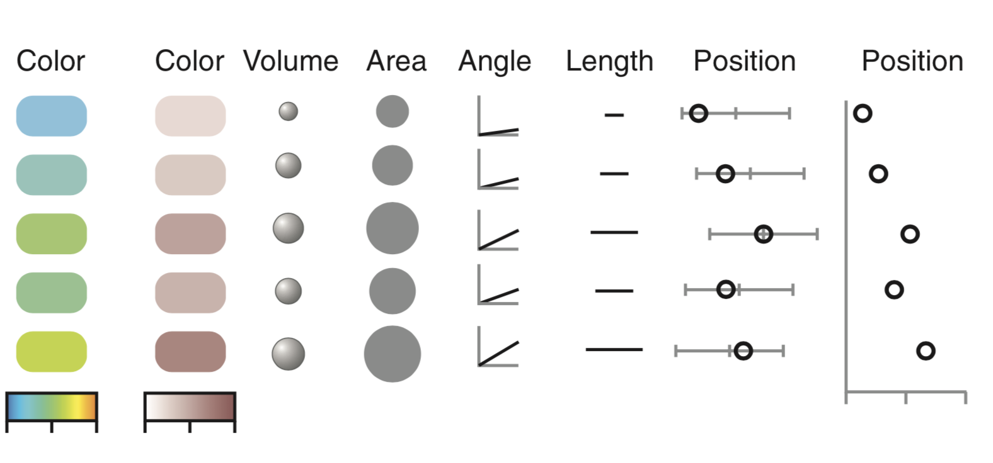
General rules for DataViz
From Bang Wong, Visual Strategies for Biological Data, Nature Collections

Slide 13
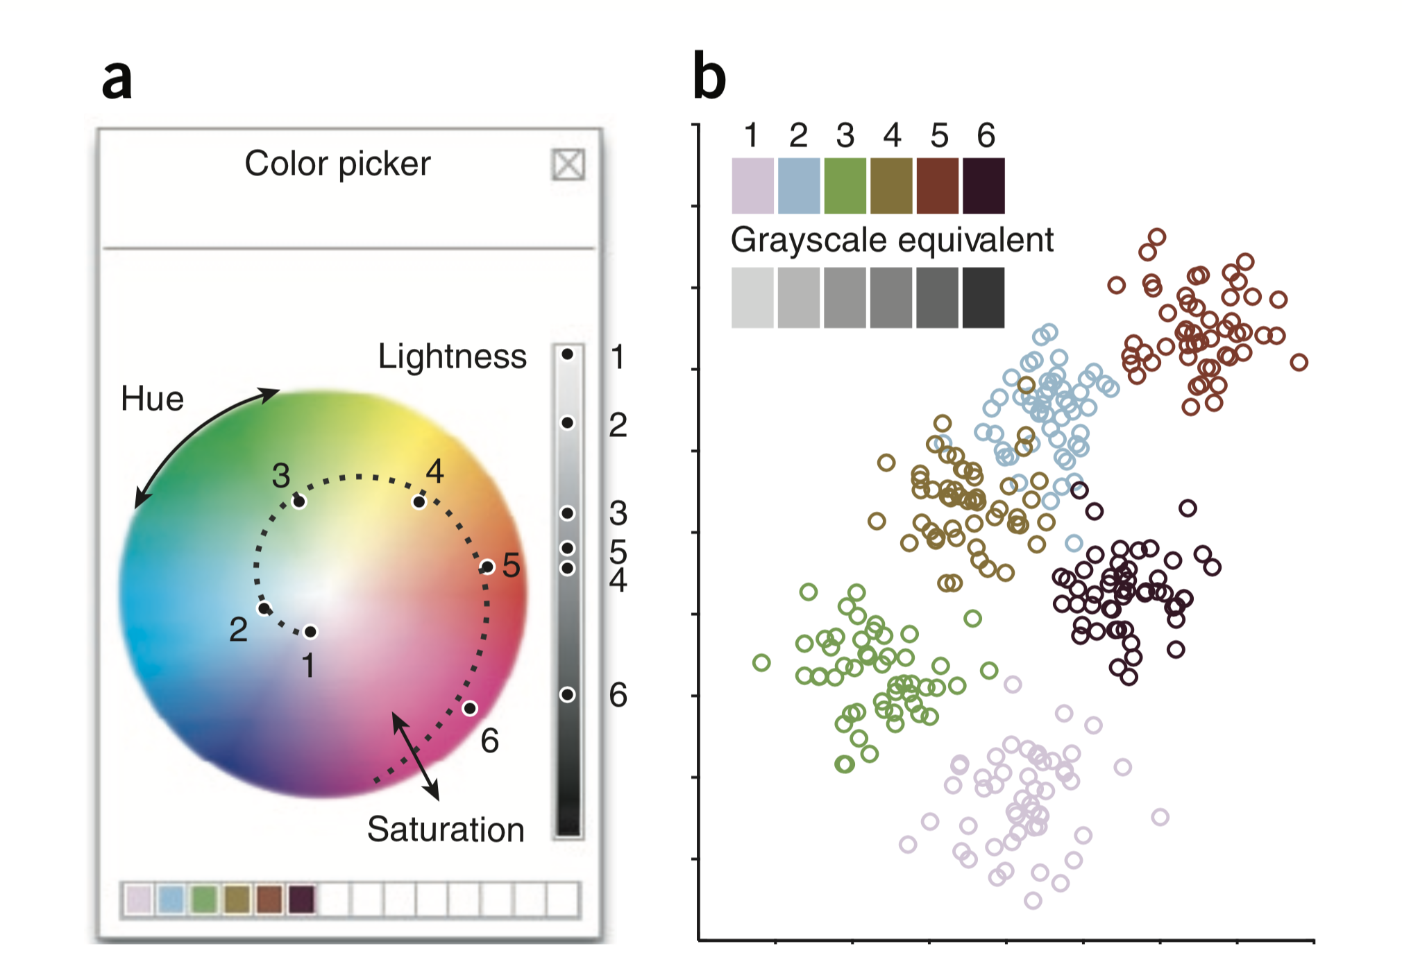
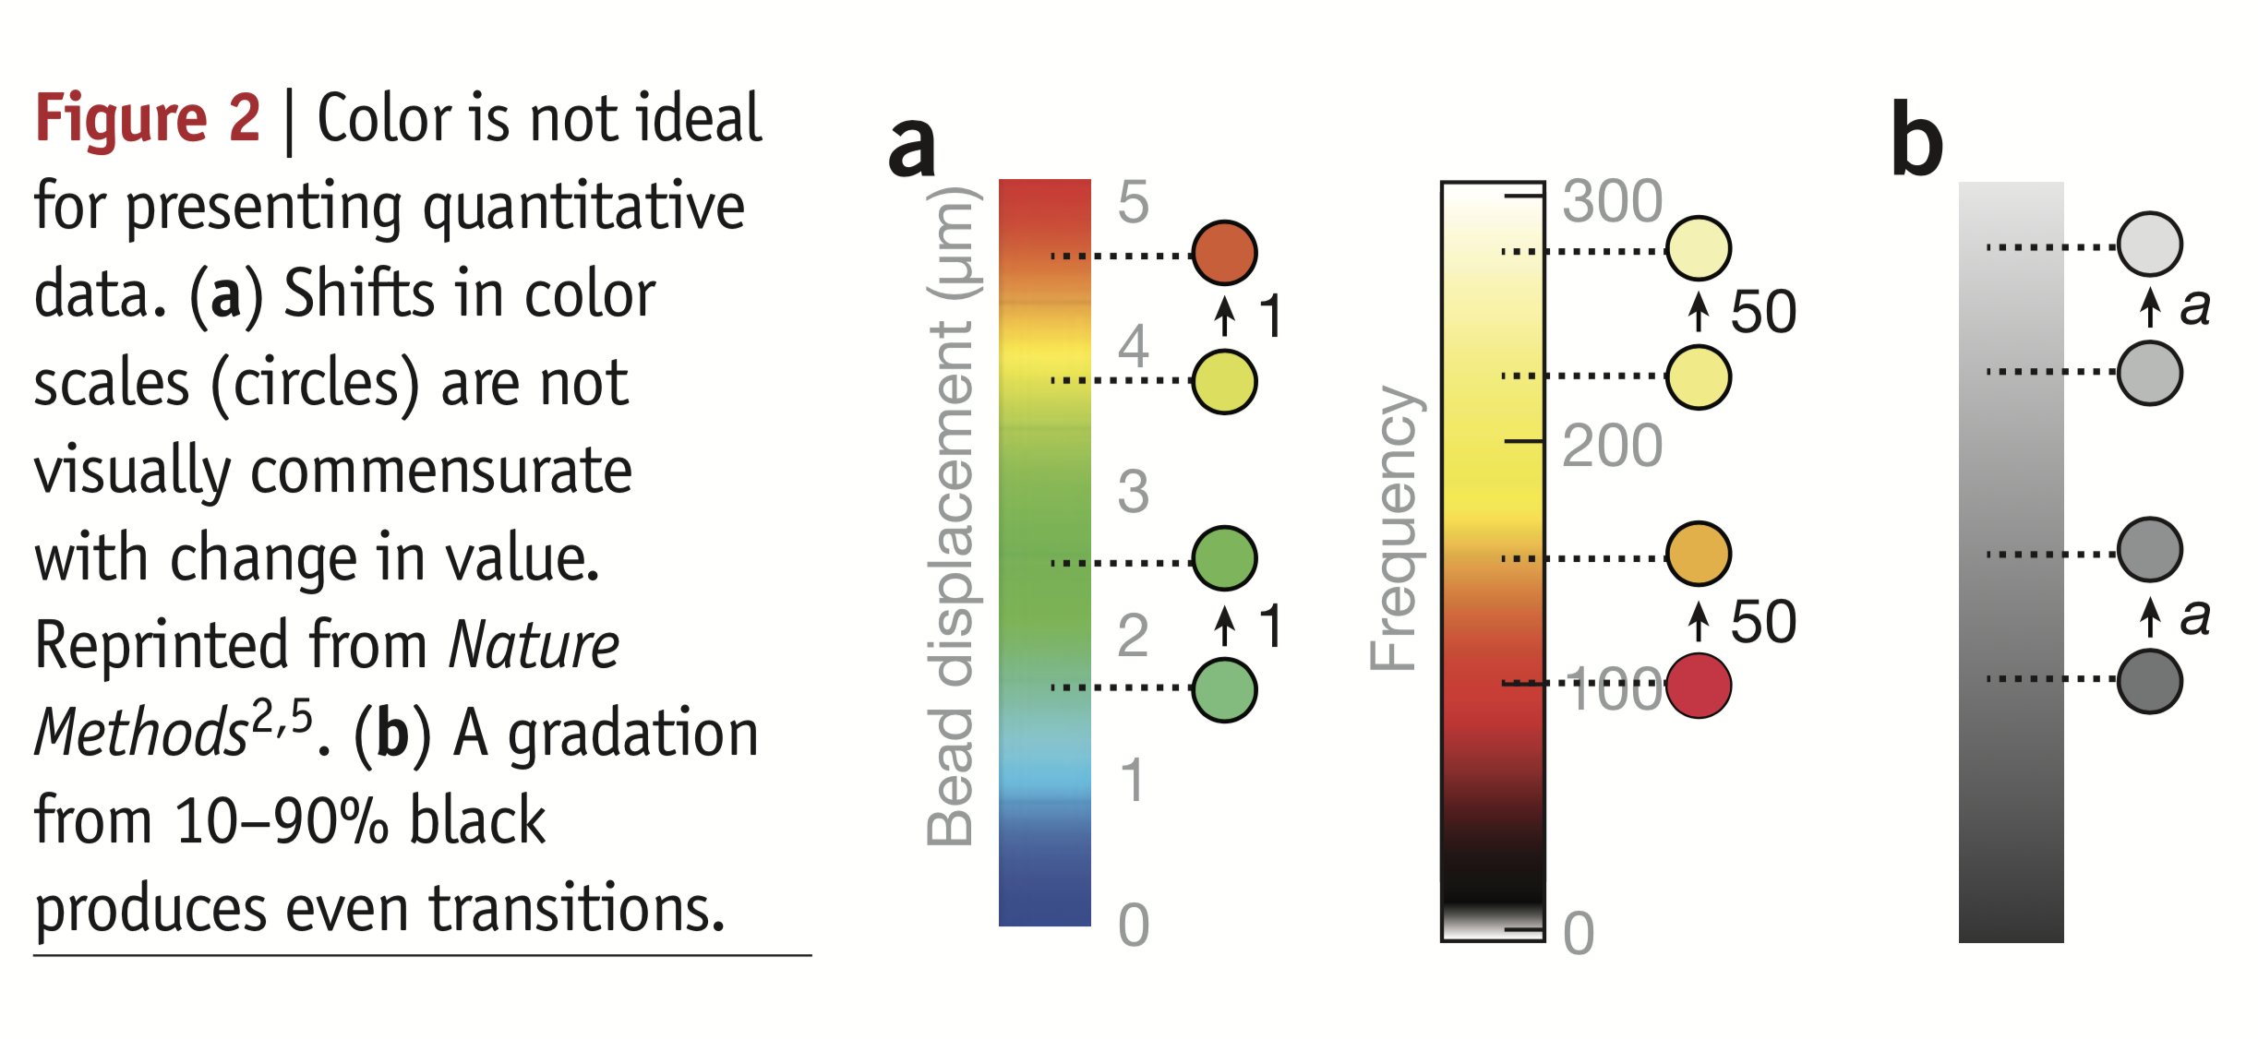
General rules for DataViz
Color is not ideal for presenting quantitative data because shifts in color scales are not the same as changes in value. Black to white transitions are easier to discern.
From Bang Wong, Visual Strategies for Biological Data, Nature Collections
Notes:
Color is not ideal for presenting quantitative data because shifts in color scales are not the same as changes in value

Slide 14
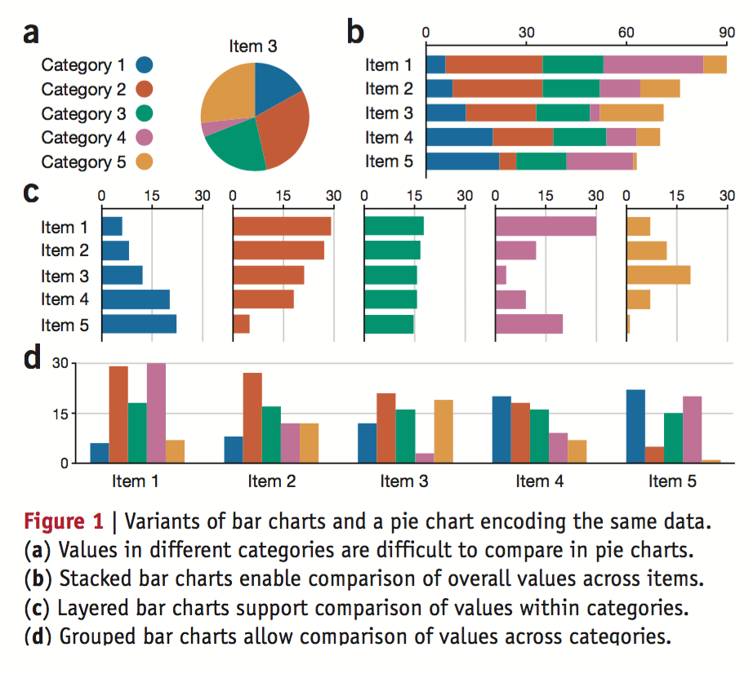
What To Do
From Bang Wong, Visual Strategies for Biological Data, Nature Collections

Slide 15
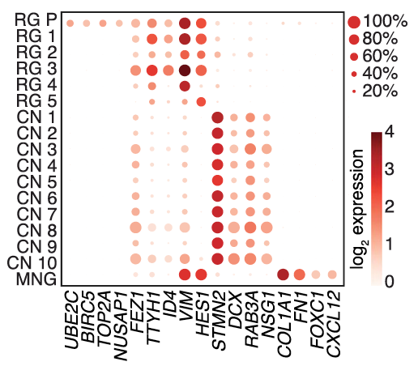
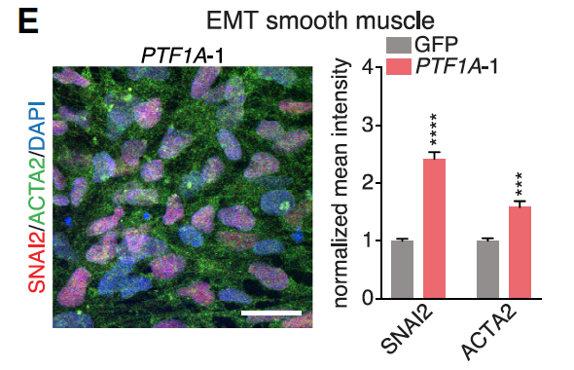
What To Do
Joung et al., Cell 2023

Slide 16
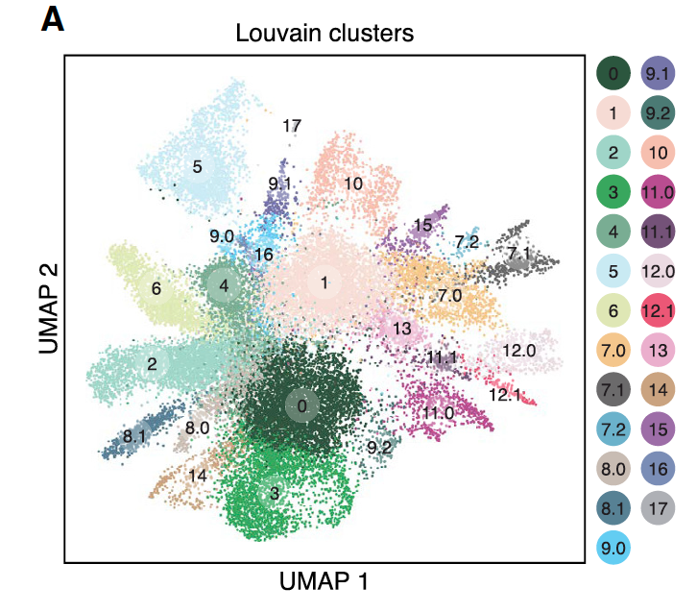
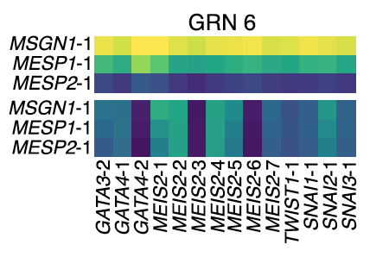
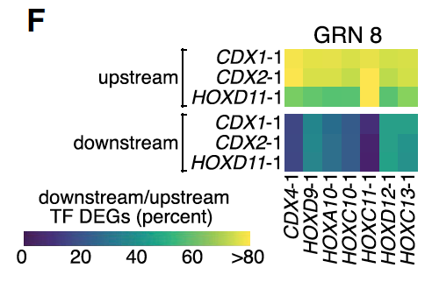
What To Do
Joung et al., Cell 2023
Notes:
.

Slide 17
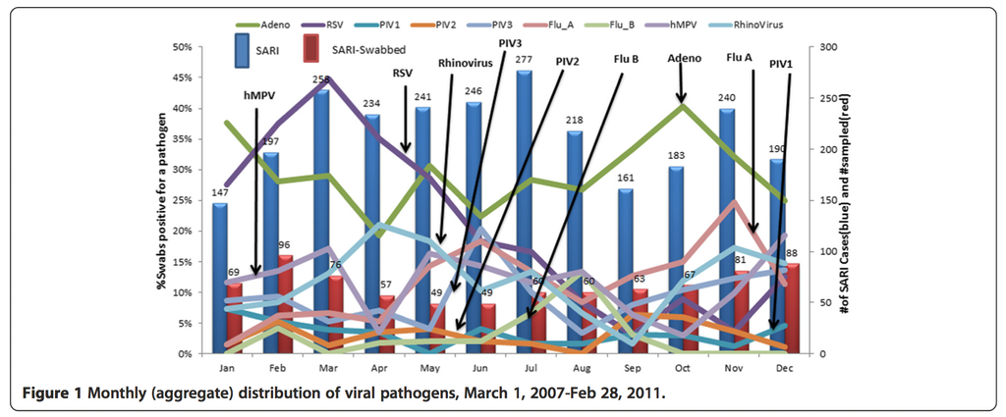
What NOT To Do

Slide 18
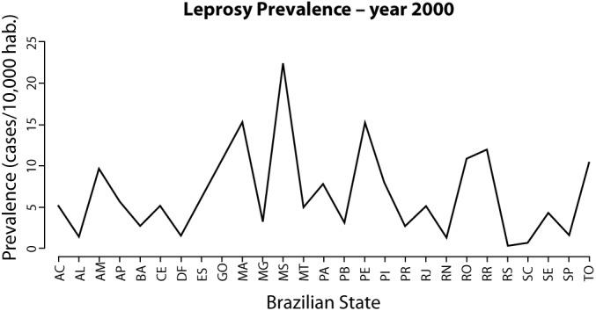
What NOT To Do

Slide 19
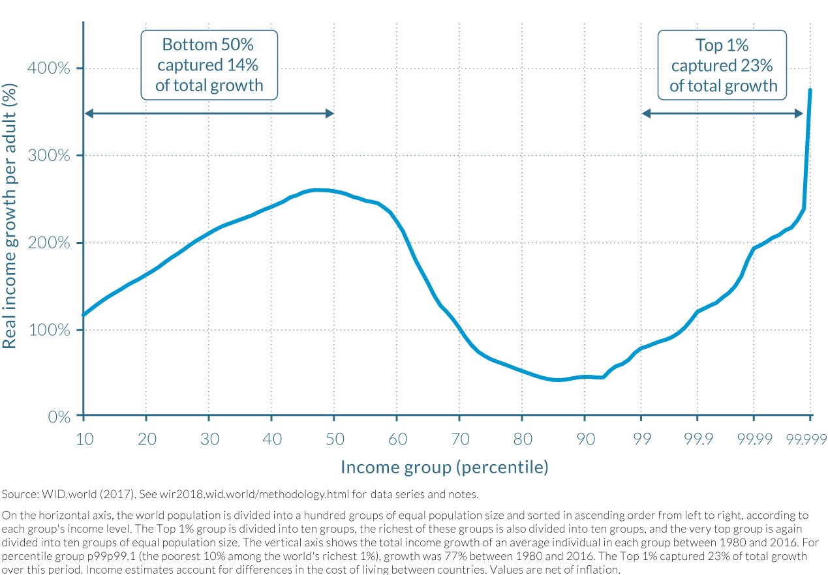
What NOT To Do

Slide 20
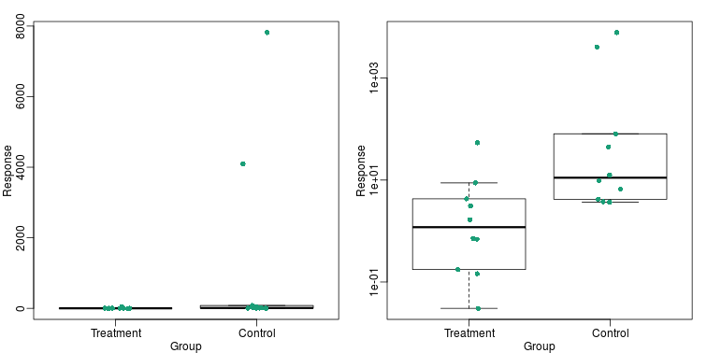
What NOT To Do

Slide 21
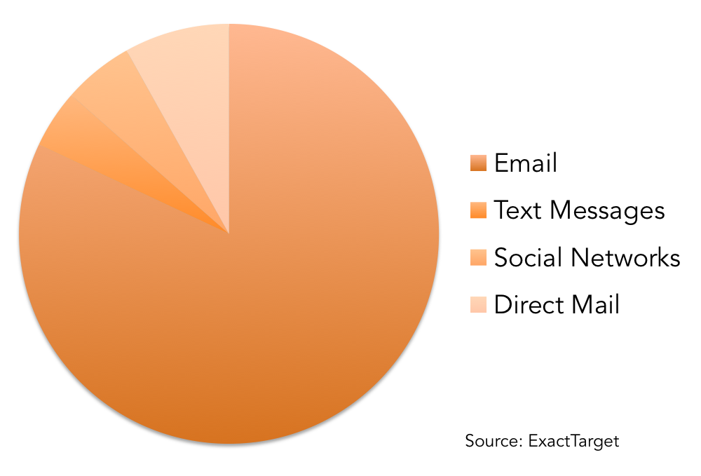
What NOT To Do

Slide 22
External Resources
Books
The Visual Display of Quantitative Information
Knowledge is Beautiful
Storytelling With Data
Websites
Viz Palette
Visual Strategies for Biological Data
Fundamentals of DataViz

